Slide 1


Vision Versus Execution: Implementing Continuous Delivery
Wednesday, October 22, 2014
Presenter: Marc Priolo
Company: Urban Science

Slide 2
Agenda
Introduction
Challenges & Solution?
First Approach
Second Approach
Lessons Learned & Next steps

Slide 3
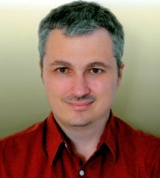
Marc Priolo
Software Configuration Manager
Over 15 years of industry experience
Consultant
DBA
Technical Support (manager)
Release Management (manager)
Current focus is on helping Urban Science deliver high-quality software frequently and reliably through implementing “Continuous Delivery” best practices.

Slide 4
We are Urban Science.
We are Urban Science.
We are automotive retail performance experts that increase market share and improve profitability for clients in more than 60 countries.
Since 1977, we have solved the toughest business challenges through a unique combination of:
Scientific analysis
Process-optimizing software
Experienced, practical consultants
Notes:
Urban Science is an innovative company that provides solutions that optimize the performance of sales and distribution channels for our clients around the world.

Slide 5
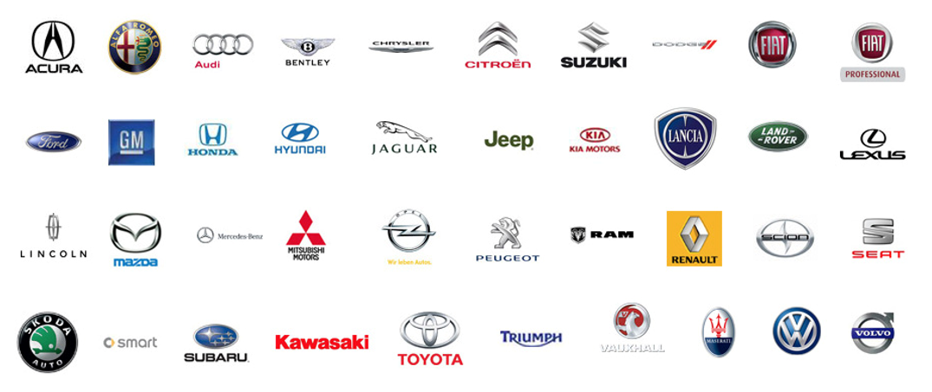

Slide 6
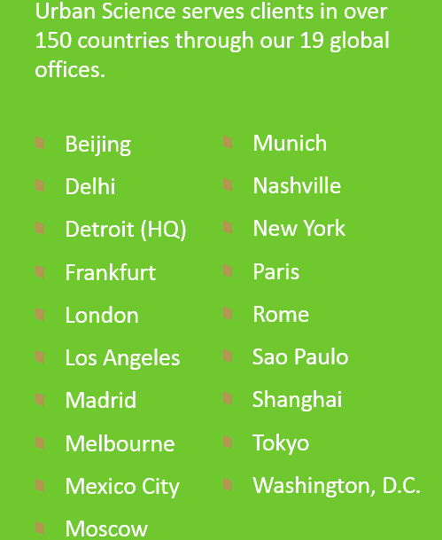
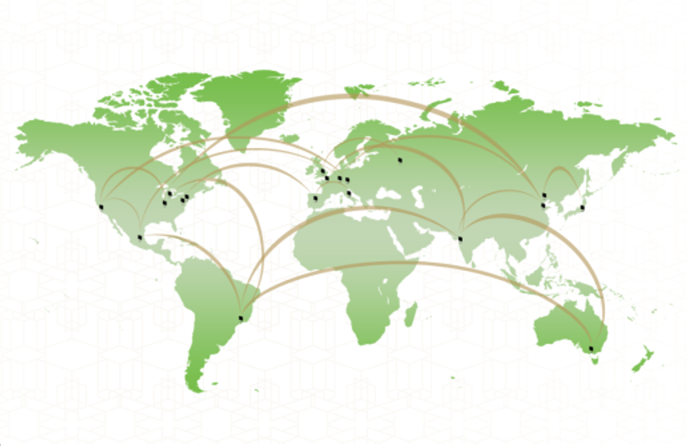
A Global Perspective

Slide 7
Challenges: In House Products
Globally Distributed Teams
Large Client Base
20+ Unique Products
Client Customizations

Slide 8

Challenge: (No) Standards
Missing development standards
Missing environment standards
Notes:
Note: Mainly legacy.
Missing development standards:
versioning standards or naming conventions
Missing environment standards”
deployment standards or cross product awareness standards

Slide 9

Challenge: deployments
Packages
Deployments
Notes:
Note: nature of our business and some of our legacy solution configurations many require frequent migrations
Packages:
Installation notes may exceed 10 pages with “GOTO” logic
Installation packages and build notes are custom for each environment
Completely manual. No installers or scripts
Deployments:
Multi-tiered, multi-phased deployments
Staging installation packages and access to servers
Limited deployment time and resources

Slide 10

Challenge: environment
Data Center
Server
Notes:
Data Center View:
6 Data centers around the world
Not all environments have domains
Environments inconsistent
Server View:
Environments shared
Each product/customer combination is uniquely deployed to as many as 6 environments

Slide 11
Why change?
Increase Scalability
Increase Consistency
Increase Efficiency
Increase Expediency
Reduce Complexity

Slide 12
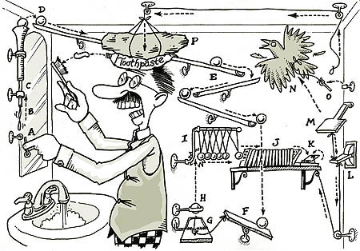
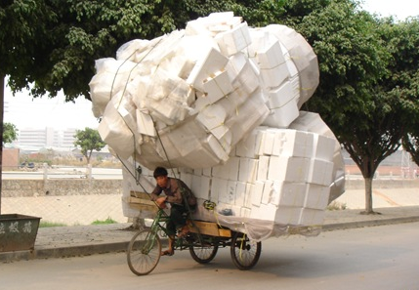
The real reason
Deployment Complexity reaching limits
Deployment Capacity reaching limits

Slide 13
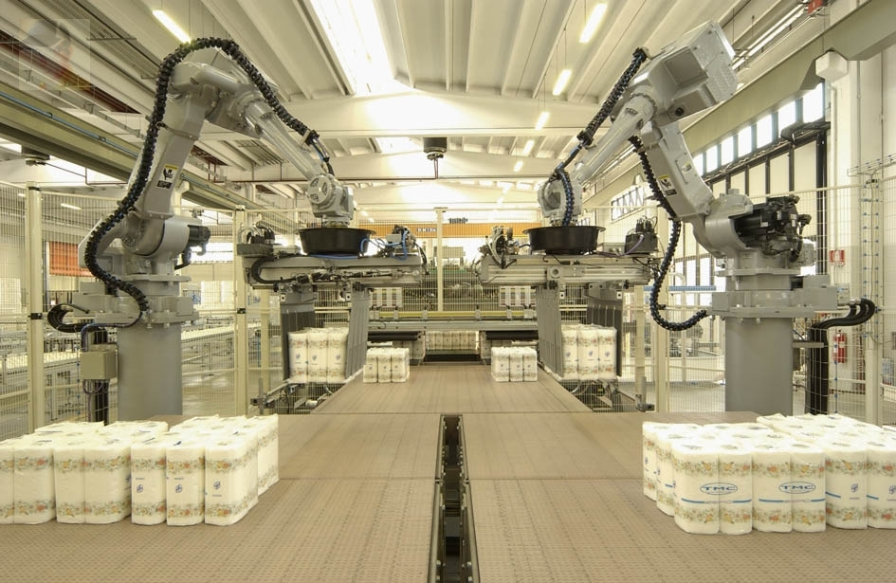
Change – Automation
Goals for automation
Increase!
Reduce!
Standardize!
Notes:
Increase:
Deployment capacity & Deployment consistency
Reduce:
deployment time
human error & complexity
Standardize:
Single source of truth
Single-click deployments

Slide 14

Automation Suite
Why ElectricCommander?
Faster deployment times
More efficient use of IT resources and infrastructure
Notes:
Why ElectricCommander?
We looked at 4 products
Create best practices and standardize common procedures
Deployment workflow automation
Faster deployment times
Manage all software artifacts
More efficient use of IT resources and infrastructure
Security and scalability
Visibility and reporting into the deployment process

Slide 15

Where do we start?
We have a choice.
The most visible:
Hardest to perform manual deployments & newer projects?
The most mundane:
Mature, established and repetitious deployments.
Automate everything!
Where do we start?

Slide 16
Approach 1: the most Visible
But why?
Notes:
Hardest to perform
Most time consuming
Newer projects
High failure rates
Visible to executives
Infrequent

Slide 17
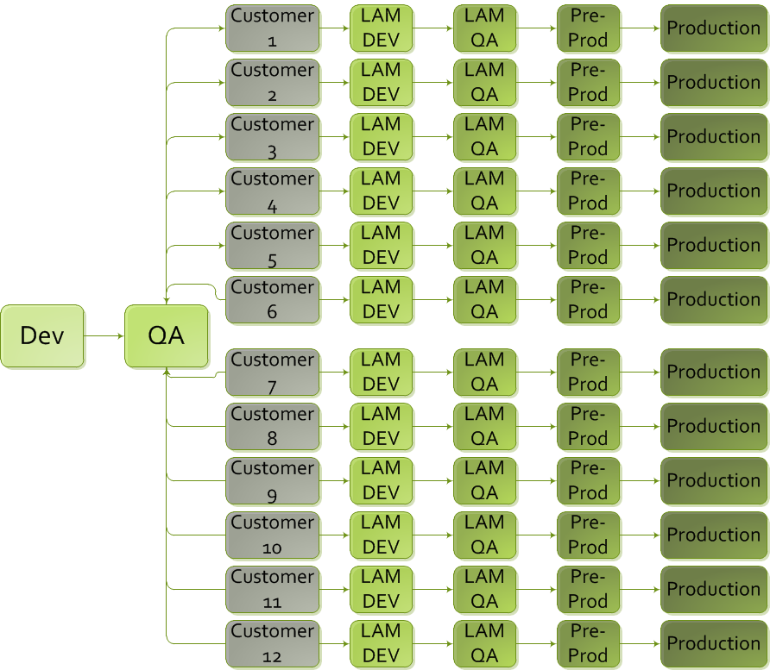
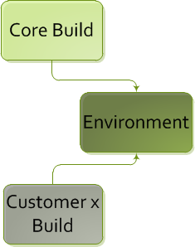
Strategy
Before Automation
After Automation

Slide 18
INITIAL Results in QA
Before ElectricCommander
With ElectricCommander
1 deployment a day at 1 hour
5 days of deployments a week
7 deployments at 1 hour each
12 Deployments a week
or
12 Hands-on hours a week total
8 deployments a day at 50 minutes
5 days of deployments a week
40 Deployments a week
or
4 Hands-off hours a week total
+
+
+

Slide 19

Shortcomings
Challenges
While required by SW Product Engineering, not required by client teams
Deployment requirements kept changing
Required up front time invested from all teams
Restrictions
Initial/Full deployments still involved manual steps
Upper level environments required deployment resource and scheduling
One automation SME in the organization
Notes:
Challenges:
While required by SW Product Engineering, not required by client teams
Deployment requirements kept changing
Required up front time invested from all teams
Restrictions:
Initial/Full deployments still involved manual steps
Upper level environments required deployment resource and scheduling
One automation SME in the organization

Slide 20
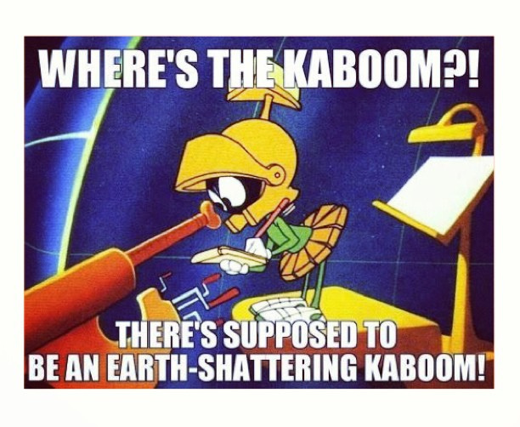
Outcome
Pros
Reduce human error
Reduce complexity
Cons
Minimal deployment speed difference for upper environments
Low adoption rate among client teams
ROI on automation more than ½ a year
Notes:
Pros:
Reduced human error
Reduced complexity
Cons:
Minimal deployment speed difference for upper environments
Low adoption rate among client teams.
ROI on automation more than ½ a year.

Slide 21
Approach 2: the most mundane
But why?
Notes:
Most frequent
Large quantity
Mature
Established
Repetitious
Not changing
Low failure rates

Slide 22

Revised Goals
Deployments are repeatable and able to be done manually
Deployments do not require scheduled resources
Target teams eager to automate
Notes:
Original goals:
Reduce deployment time
Reduce human error
Deployment consistency
Drastically reduce complexity
Single source of truth

Slide 23
Strategy
Before Automation
After Automation

Slide 24
Results in Production
Before ElectricCommander
With ElectricCommander
60 customer deployments at 2.25 hours
1.5 deployments a month
90 Deploy Notes
90 Unique Deployments
90 Deployment Tickets
90 Deployments
202.5 Hands-on deploying/testing hours
30 customer deployments at 1 hour
1.5 deployments a month
01 Deploy Note
45 Unique Deployments
00 Deployment Tickets
45 Deployments
45 Hands-on testing hours
x
x

Slide 25
Results statistics

Slide 26

Outcome
Pros
Higher quality of work
1700+ resource hours saved
ROI less than two months
Cons
No cons
Notes:
High customer satisfaction
Switched from a pull model to a push model. This eliminated reserving time that could not be used.
Eliminate deployments being cancelled due to resource constraints
Able to perform more deployments
Higher quality of work for people involved in deployments.
1700+ resource hours a year saved
ROI on automation in less than two months

Slide 27

Lessons learned
If I could do it again:
Get training & Professional Services
Most mundane first
Initially target teams eager to automate
Notes:
Most mundane first
All teams must buy in
Teams elect to automate
Get training & Professional Services
Be case sensitive aware
Understand EC’s thought process

Slide 28

Next Steps - Projects
2014
Automate 90 monthly European code and database established deployments
Automate 45 monthly USA code and database established deployments
2015 and beyond
Implement end to end test automation
Automate and standardize hardest to perform manual deployments & newer projects
We’re just getting started.
Notes:
Anticipating 3000+ annual resource hours saved

Slide 29
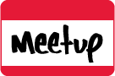
Resources
Electric Cloud Online resources:
Ask Electric Cloud = http://ask.electric-cloud.com/
ElectricCommunity on GitHub = https://github.com/electriccommunity
Southern California resource:
EC Brewery Meetup group = http://www.meetup.com/ec-brewery

Slide 30

Questions?

Slide 31
Thank You!
Marc Priolo
Software Configuration Manager
Urban Science

